Slide 1
Deadlock Analysis with Differential Equations

Slide 2
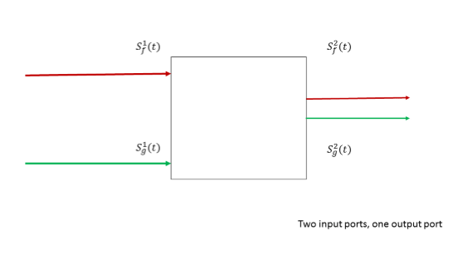
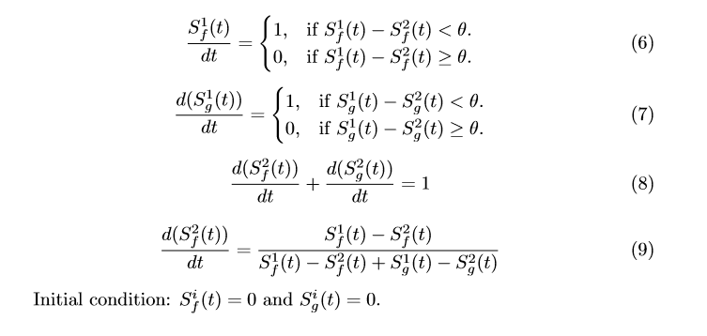
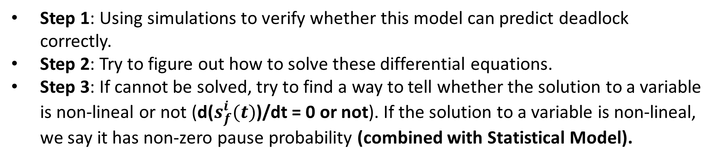
Differential Equations for Deadlock Analysis
Step 1: Using simulations to verify whether this model can predict deadlock correctly.
Step 2: Try to figure out how to solve these differential equations.
Step 3: If cannot be solved, try to find a way to tell whether the solution to a variable is non-lineal or not (d($s_{f}^{i}(t)$)/dt = 0 or not). If the solution to a variable is non-lineal, we say it has non-zero pause probability (combined with Statistical Model).

Slide 3
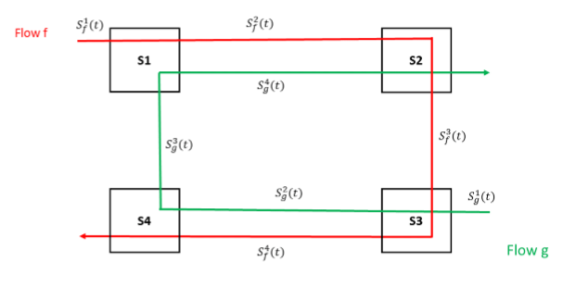
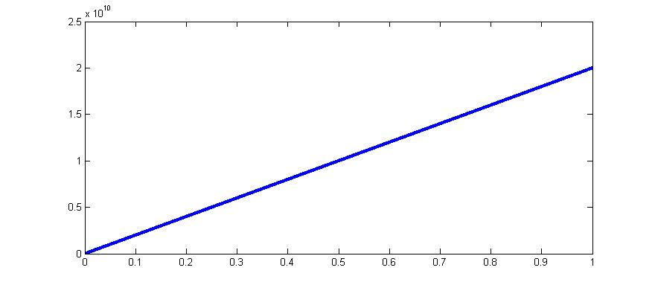

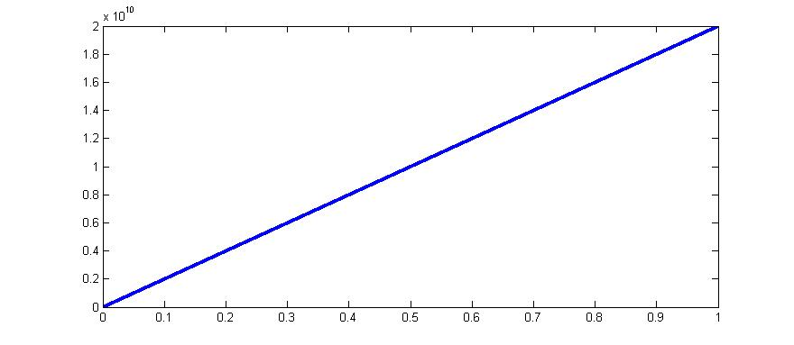




Differential Equations for Deadlock Analysis – Simulation results of 2-flow 4-switch case
Setting:
link capacity =40Gbps,
simulation step = 10us
d($s_{f}^{1}(t)$)/dt = 20.00Gbps
d($s_{f}^{2}(t)$)/dt = 20.00Gbps
d($s_{f}^{3}(t)$)/dt = 20.00Gbps
d($s_{f}^{4}(t)$)/dt = 20.00Gbps
  The results are consistent with our NS-3 simulation.

Slide 4
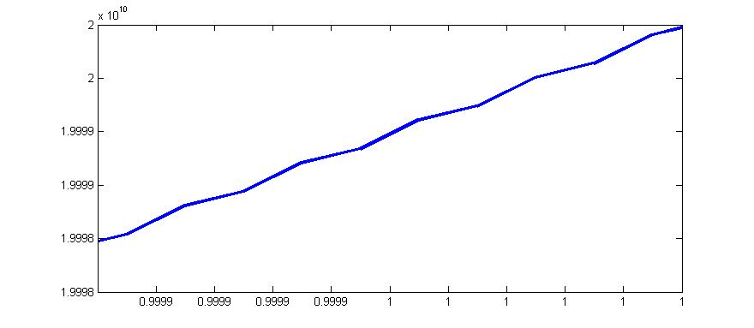
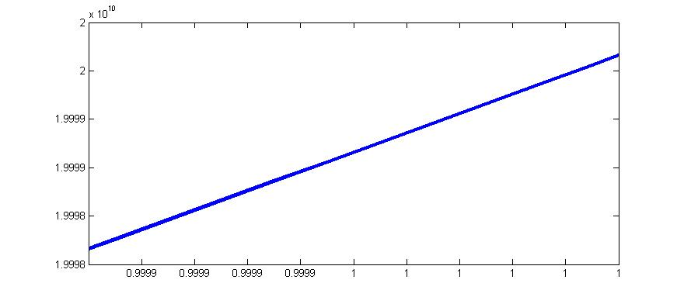
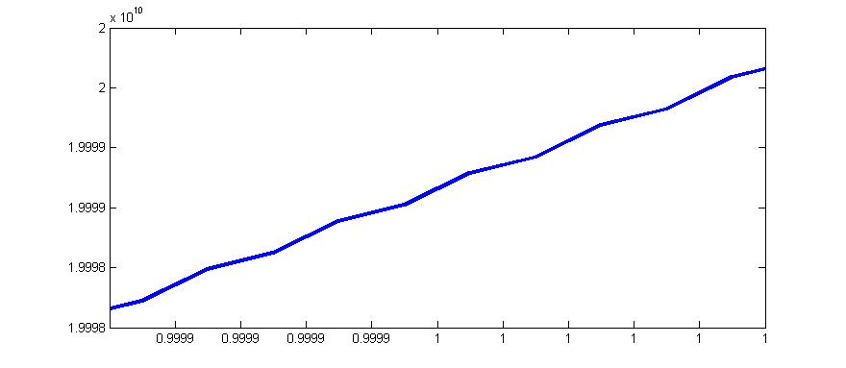
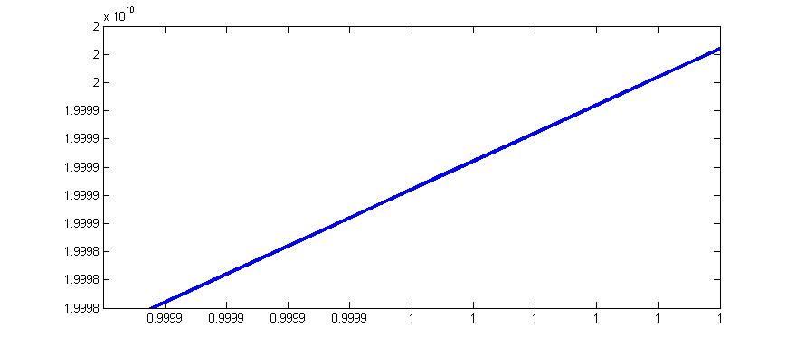




Differential Equations for Deadlock Analysis – Simulation results of 2-flow 4-switch case
Setting:
link capacity =40Gbps,
simulation step = 10us
$s_{f}^{1}(t)$: non-lineal
$s_{f}^{2}(t)$: lineal
$s_{f}^{3}(t)$: non-lineal
$s_{f}^{4}(t)$: lineal
  The results are consistent with our NS-3 simulation.

Slide 5


Differential Equations for Deadlock Analysis – Simulation results of 3-flow 4-switch case
$s_{h}^{1}(t)$
Setting:
link capacity =40Gbps,
simulation step = 10us
$s_{h}^{2}(t)$
  The solutions of differential equations indicate that deadlock will happen for 3-flow 4-switch case. The results are consistent with our NS-3 simulation.

Slide 6
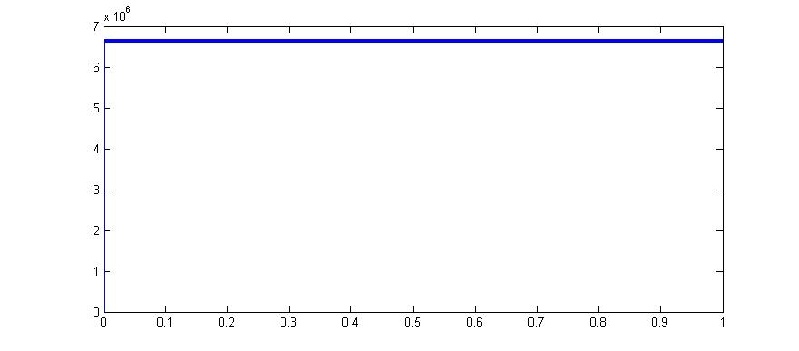
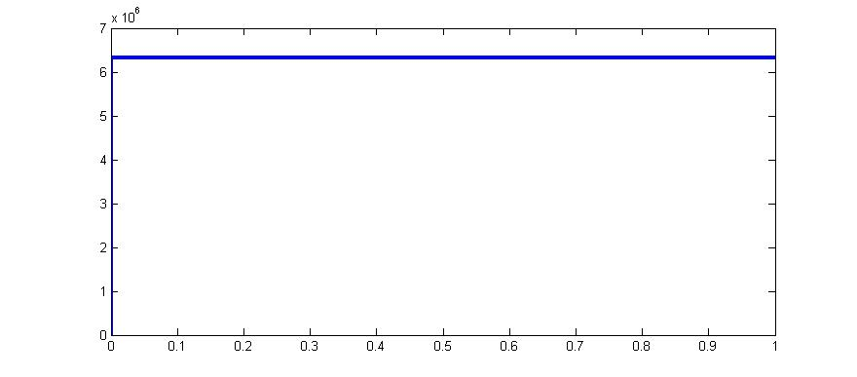
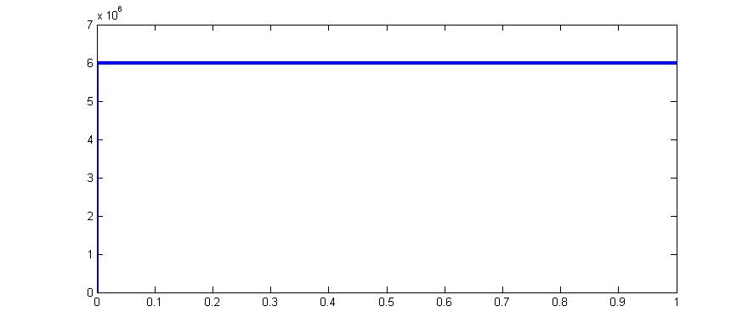
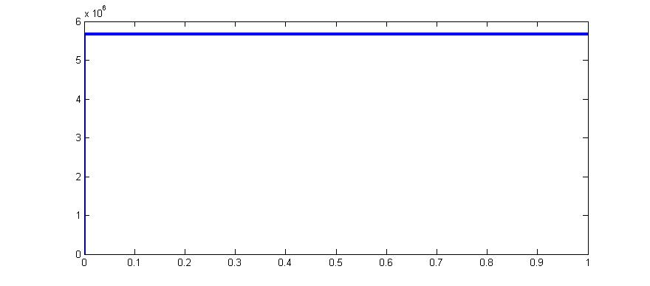
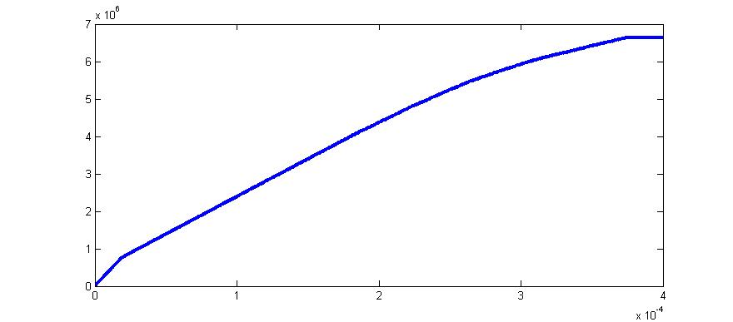
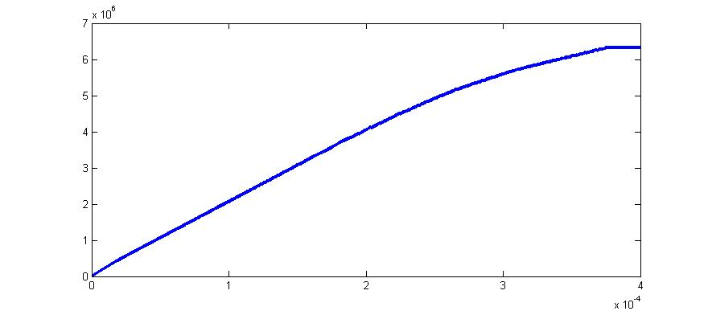
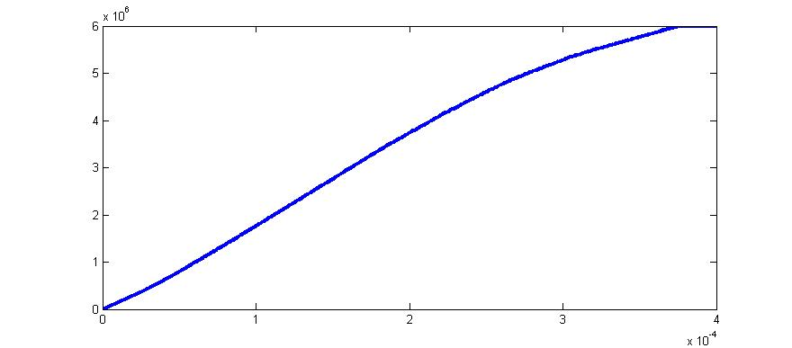
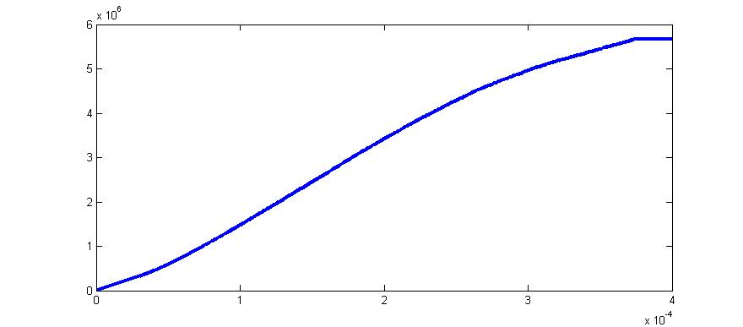
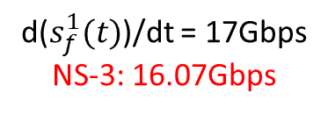
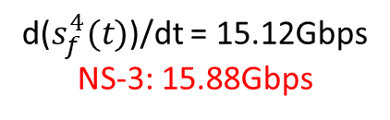


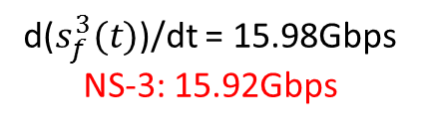


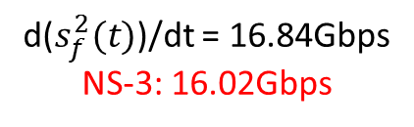
Differential Equations for Deadlock Analysis – Simulation results of 3-flow 4-switch case
$s_{f}^{1}(t)$: fixed value
$s_{f}^{2}(t)$: fixed value
$s_{f}^{3}(t)$: fixed value
$s_{f}^{4}(t)$: fixed value
d($s_{f}^{1}(t)$)/dt = 17Gbps
NS-3: 16.07Gbps
d($s_{f}^{2}(t)$)/dt = 16.84Gbps
NS-3: 16.02Gbps
d($s_{f}^{3}(t)$)/dt = 15.98Gbps
NS-3: 15.92Gbps
d($s_{f}^{4}(t)$)/dt = 15.12Gbps
NS-3: 15.88Gbps

Slide 7
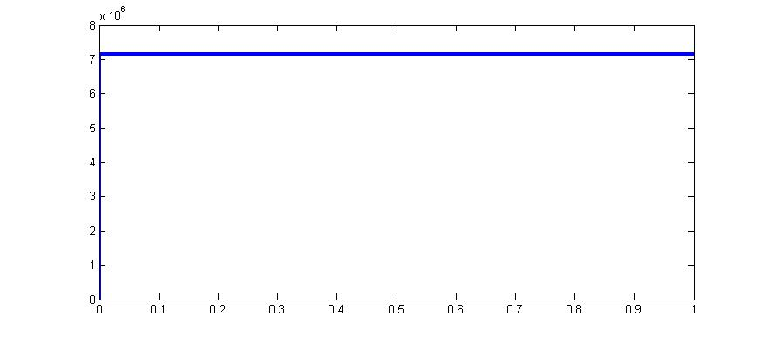
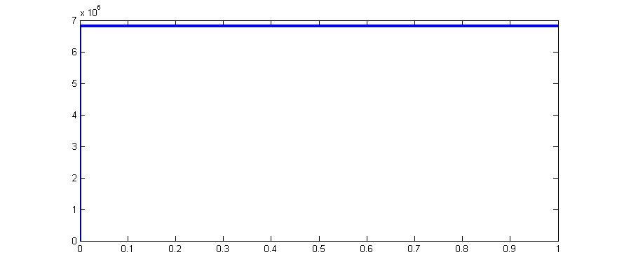
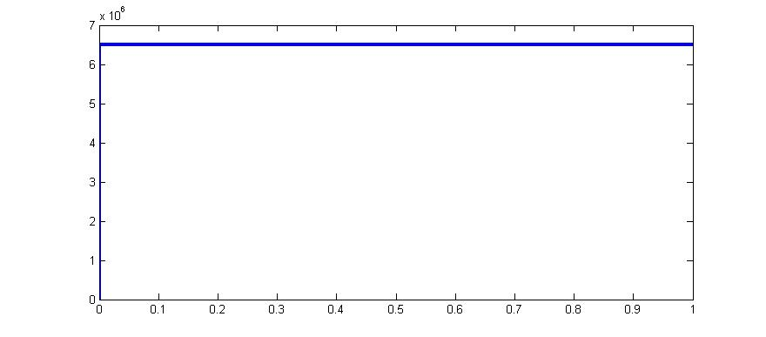
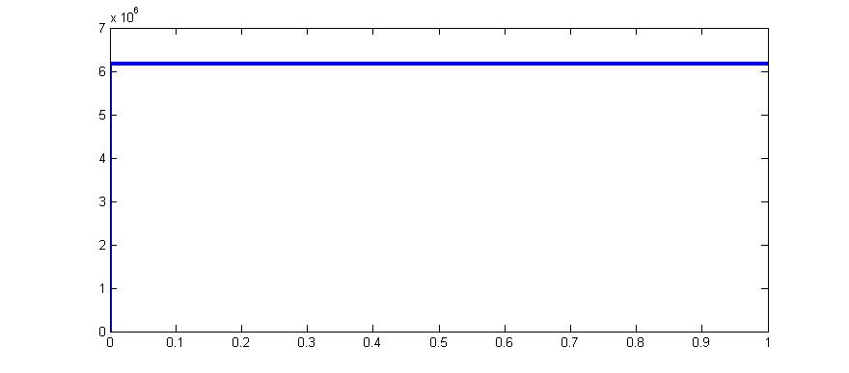
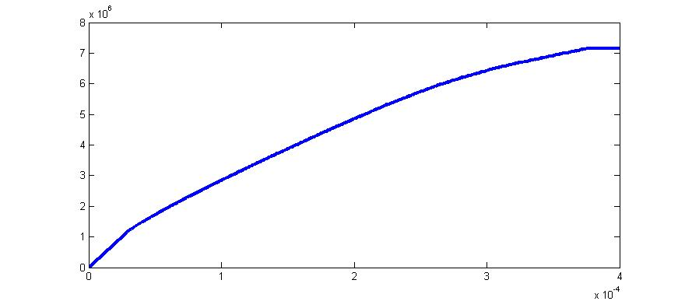
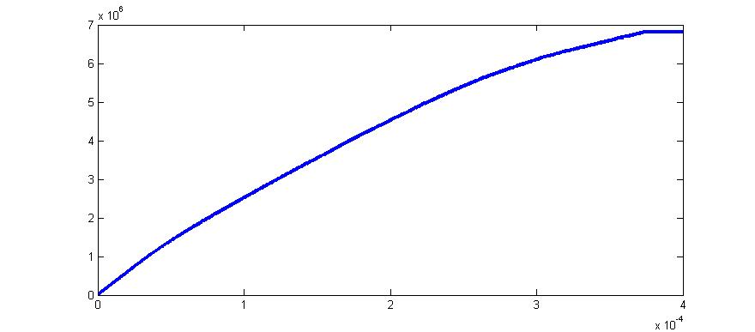
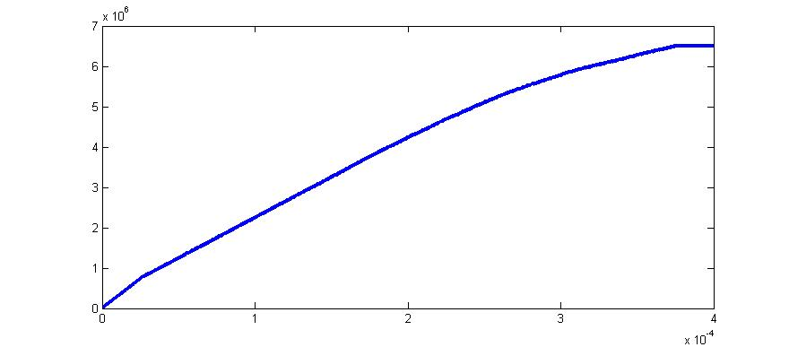
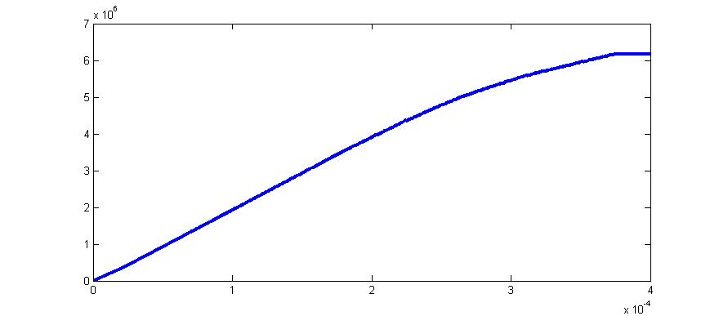

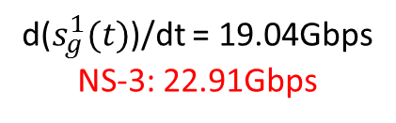

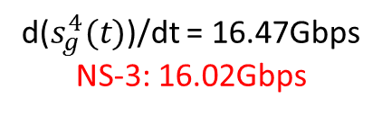

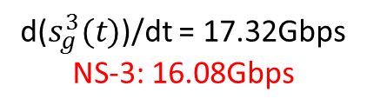

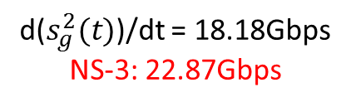
Differential Equations for Deadlock Analysis – Simulation results of 3-flow 4-switch case
$s_{g}^{1}(t)$: fixed value
$s_{g}^{2}(t)$: fixed value
$s_{g}^{3}(t)$: fixed value
$s_{g}^{4}(t)$: fixed value
d($s_{g}^{1}(t)$)/dt = 19.04Gbps
NS-3: 22.91Gbps
d($s_{g}^{2}(t)$)/dt = 18.18Gbps
NS-3: 22.87Gbps
d($s_{g}^{3}(t)$)/dt = 17.32Gbps
NS-3: 16.08Gbps
d($s_{g}^{4}(t)$)/dt = 16.47Gbps
NS-3: 16.02Gbps

Slide 8
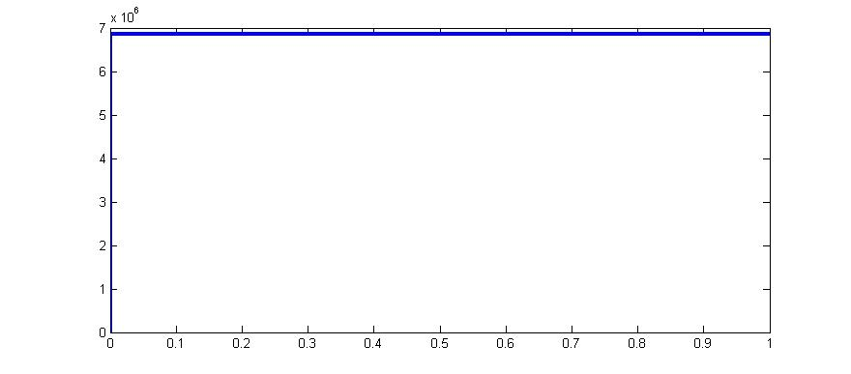
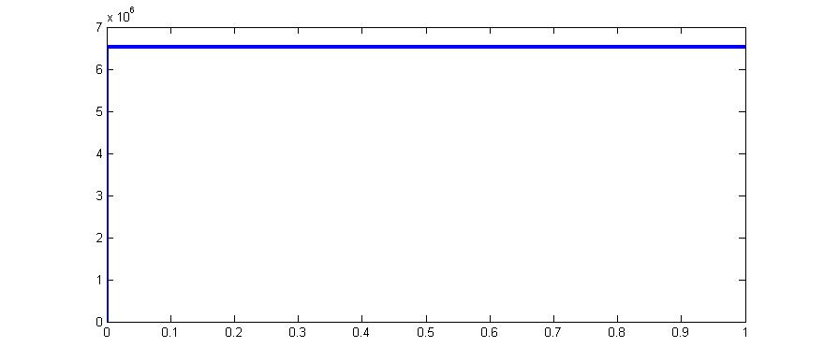
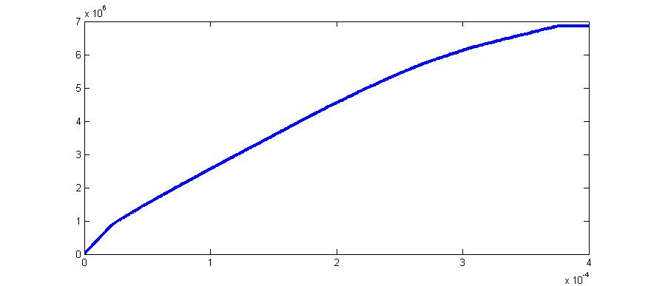
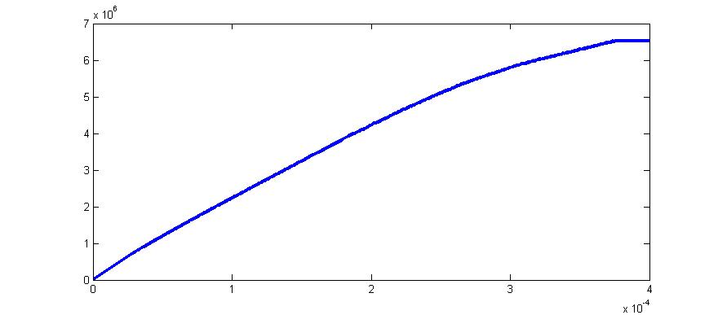

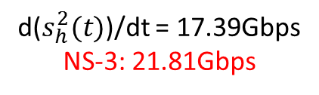
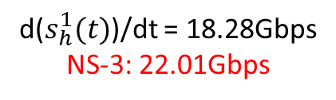

Differential Equations for Deadlock Analysis – Simulation results of 3-flow 4-switch case
$s_{h}^{1}(t)$: fixed value
$s_{h}^{2}(t)$: fixed value
d($s_{h}^{1}(t)$)/dt = 18.28Gbps
NS-3: 22.01Gbps
d($s_{h}^{2}(t)$)/dt = 17.39Gbps
NS-3: 21.81Gbps

Slide 9
flow 3
r₃ = B
r₁ = B
S1
S2
Flow 1
tx
rx
rx
tx
r₂ = B
tx-1
rx
S4
S3
Flow 2
tx-2
rx
tx
Matlab | flow 1 | flow 2 | flow 3
Source node | 17Gbps | 19.04Gbps | 18.26Gbps
Switch S1 | 16.84Gbps | 16.47Gbps
Switch S2 | 15.98Gbps | 16.47Gbps | 17.39Gbps
Switch S3 | 15.12Gbps | 18.18Gbps | 17.39Gbps
Switch S4 | 15.12Gbps | 17.32Gbps
NS-3 | flow 1 | flow 2 | flow 3
Source node | 16.07Gbps | 22.91Gbps | 22.01Gbps
Switch S1 | 16.02Gbps | 16.02Gbps
Switch S2 | 15.92Gbps | 16.02Gbps | 21.81Gbps
Switch S3 | 15.88Gbps | 22.87Gbps | 21.80Gbps
Switch S4 | 15.88Gbps | 16.08Gbps

Slide 10
Backup: NS-3 simulations for 2-flow 4-switch case

Slide 11
Case 1: set PFC threshold of all switches to 40KB
r₁ = B
S1
L1
S2
Flow 1
tx
rx
rx
tx
L4
L2
r₂ = B
tx-1
L3
rx
S4
S3
Flow 2
tx-2
rx
tx
Link delay = 0.001ms, link capacity = 40Gbps
All PFC Threshold = 40 KB, Deadlock will not happen.

Slide 12
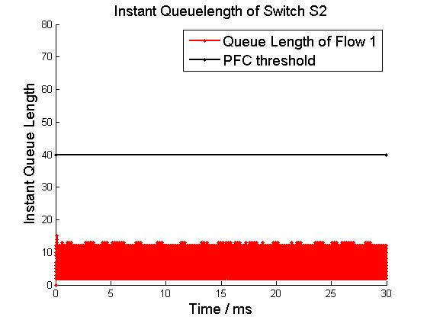
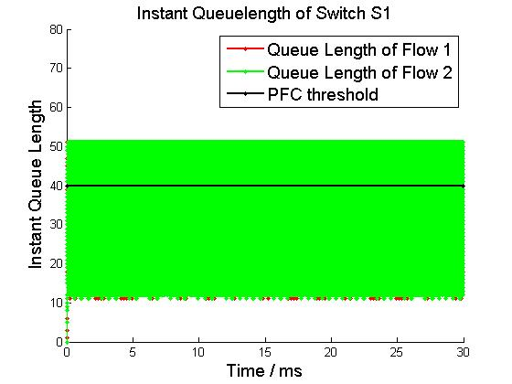
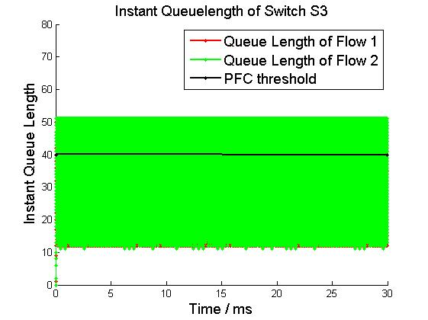
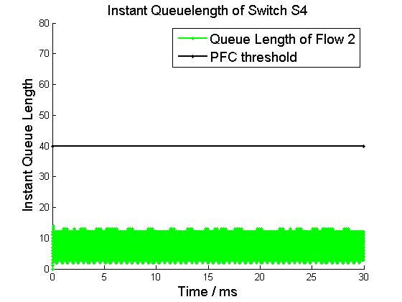
Buffer Occupation
r₁ = B
S1
L1
S2
Flow 1
tx
rx
rx
tx
L4
L2
r₂ = B
tx-1
L3
rx
S4
S3
Flow 2
tx-2
rx
tx

Slide 13
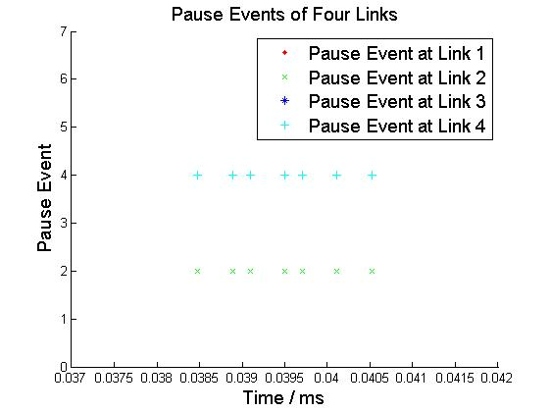
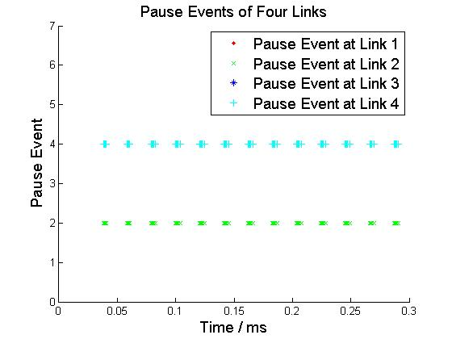
Pause Pattern
Micro View
Macro View
Pause Events only happens at L2 and L4.

Slide 14
Case 2: set PFC threshold of S2 and S4 to 1KB
r₁ = B
S1
L1
S2
Flow 1
tx
rx
PFC Threshold of RX in S4
= 1 KB
rx
tx
PFC Threshold of RX in S2
= 1 KB
L4
L2
r₂ = B
tx-1
L3
rx
S4
S3
Flow 2
tx-2
rx
tx
Link delay = 0.001ms, link capacity = 40Gbps
All Other PFC Threshold = 40 KB, Deadlock will happen.

Slide 15
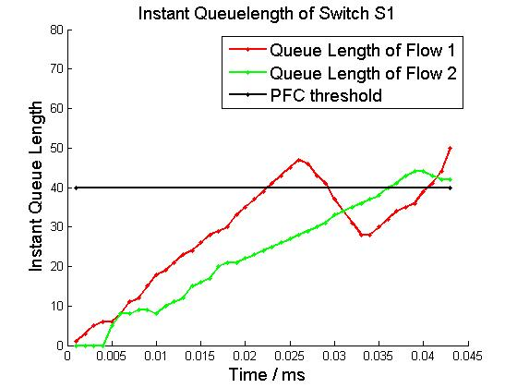
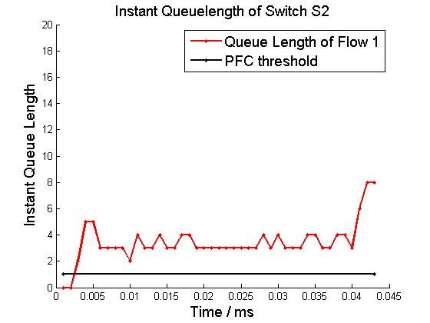
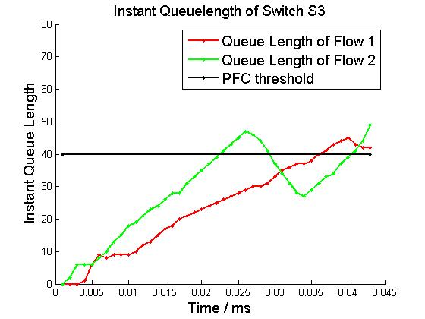
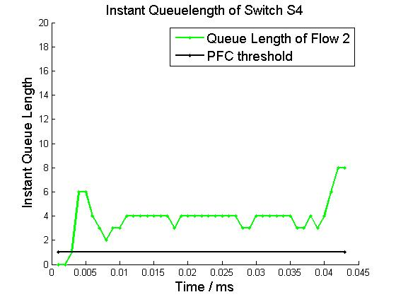
Buffer Occupation
r₁ = B
S1
L1
S2
Flow 1
tx
rx
rx
tx
L4
L2
r₂ = B
tx-1
L3
rx
S4
S3
Flow 2
tx-2
rx
tx

Slide 16


Pause Pattern
Micro View
Macro View
Deadlock occurs when four links are paused at the same time.

Slide 17
Case 3: set PFC threshold of S2 and S4 to 10KB
r₁ = B
S1
L1
S2
Flow 1
tx
rx
PFC Threshold of RX in S4
= 10 KB
rx
tx
PFC Threshold of RX in S2
= 10 KB
L4
L2
r₂ = B
tx-1
L3
rx
S4
S3
Flow 2
tx-2
rx
tx
Link delay = 0.001ms, link capacity = 40Gbps
All Other PFC Threshold = 40 KB, Deadlock will happen.

Slide 18




Buffer Occupation
r₁ = B
S1
L1
S2
Flow 1
tx
rx
rx
tx
L4
L2
r₂ = B
tx-1
L3
rx
S4
S3
Flow 2
tx-2
rx
tx

Slide 19


Pause Pattern
Micro View
Macro View
Deadlock occurs when four links are paused at the same time.

Slide 20
Case 4: set PFC threshold of S4 to 1KB
r₁ = B
S1
L1
S2
Flow 1
tx
rx
PFC Threshold of RX in S4
= 1 KB
rx
tx
L4
L2
r₂ = B
tx-1
L3
rx
S4
S3
Flow 2
tx-2
rx
tx
Link delay = 0.001ms, link capacity = 40Gbps
All Other PFC Threshold = 40 KB, Deadlock will happen.

Slide 21




Buffer Occupation
r₁ = B
S1
L1
S2
Flow 1
tx
rx
rx
tx
L4
L2
r₂ = B
tx-1
L3
rx
S4
S3
Flow 2
tx-2
rx
tx

Slide 22


Pause Pattern
Micro View
Macro View
Deadlock occurs when four links are paused at the same time.

